Slide 1
Infrastructure for Life Science Innovation
November 2021
CEO of BII Jens Nielsen

Slide 2





USD 856M
Grants awarded in 2017
Scientific research Diabetes treatment Innovation
Education & outreach Humanitarian and social causes
BII is a non-profit foundation funded with 470M EUR from the Novo Nordisk Foundation
Divid
end
s
100% SHARES
USD 51B AUM
USD 3.1B
Investment result in 2017
Principal investments Venture investments Seed investments Financial investments
28.1% SHARES
75.5% VOTES
25.5% SHARES
71.2% VOTES

Slide 3




BII is an addition to the Novo family ecosystem, but is different from The Novo Foundation and Novo Holding - both in terms of focus area and funding type.
Build translational capacity at Research Institutions & Clinics
Mature projects through Discovery, Acceleration & Incubation
Build the Team and take active ownership in company portfolio
Focus Areas
Funding Type
Grants
Grants & Convertible loans
Investments

Slide 4

BII helps start-ups become investment ready by bridging the gap between academia and business.
ACADEMIA
BUSINESS

Slide 5
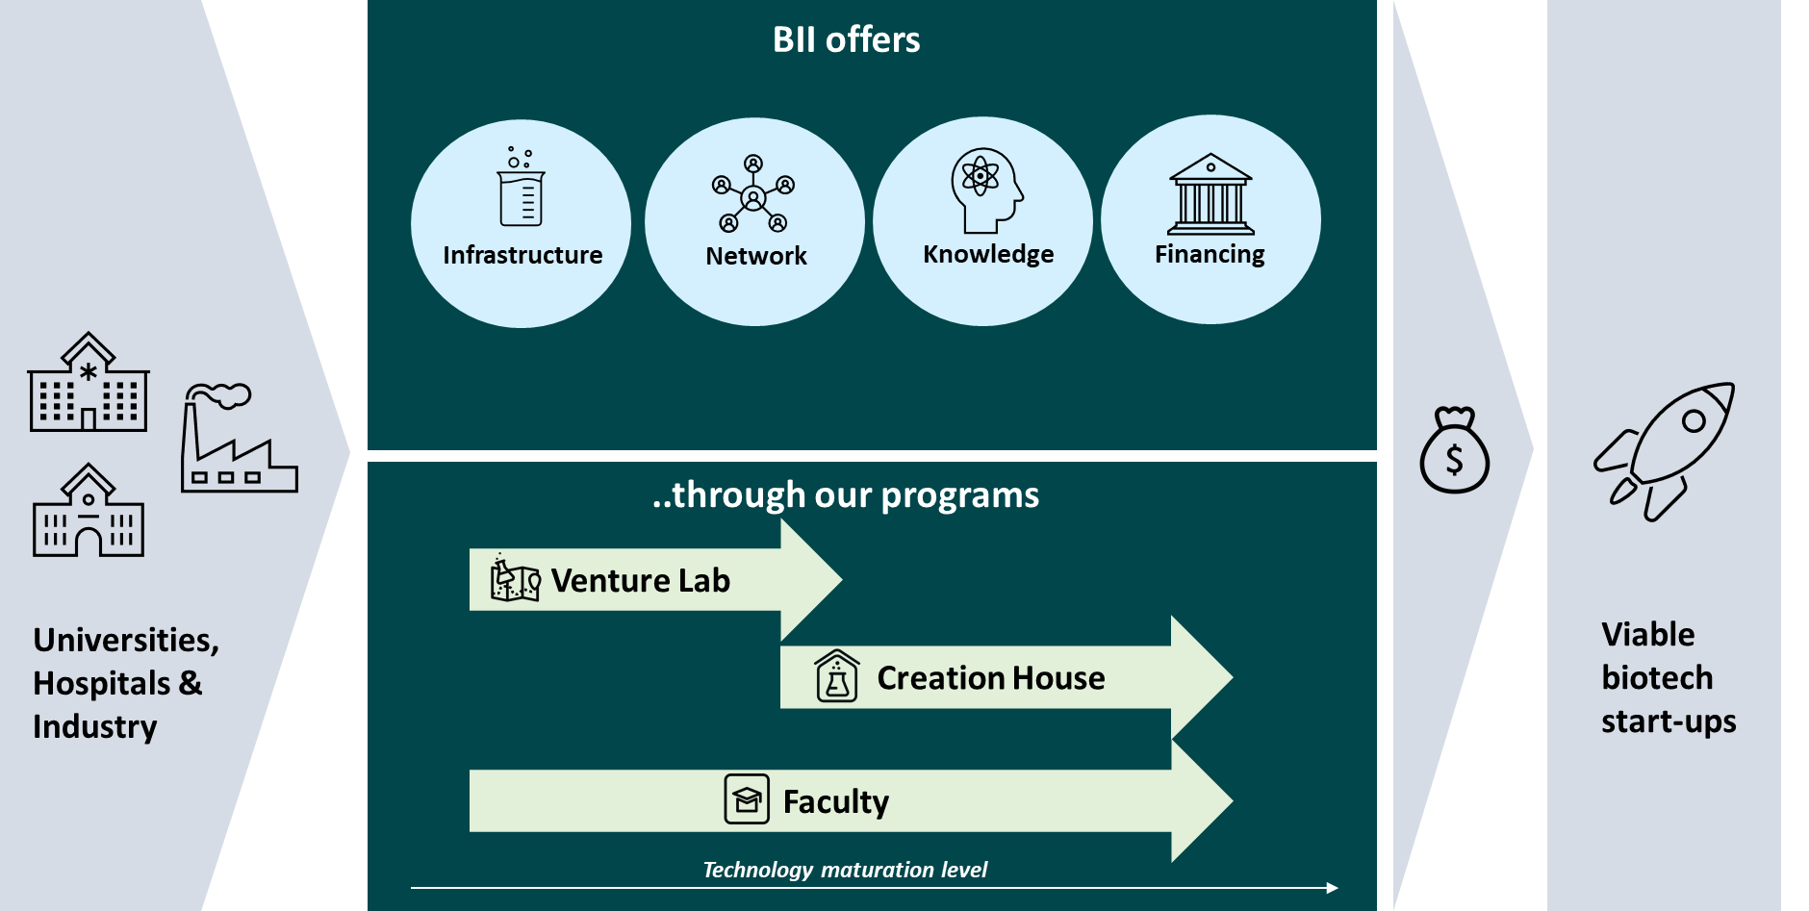
The BII Model

Slide 6
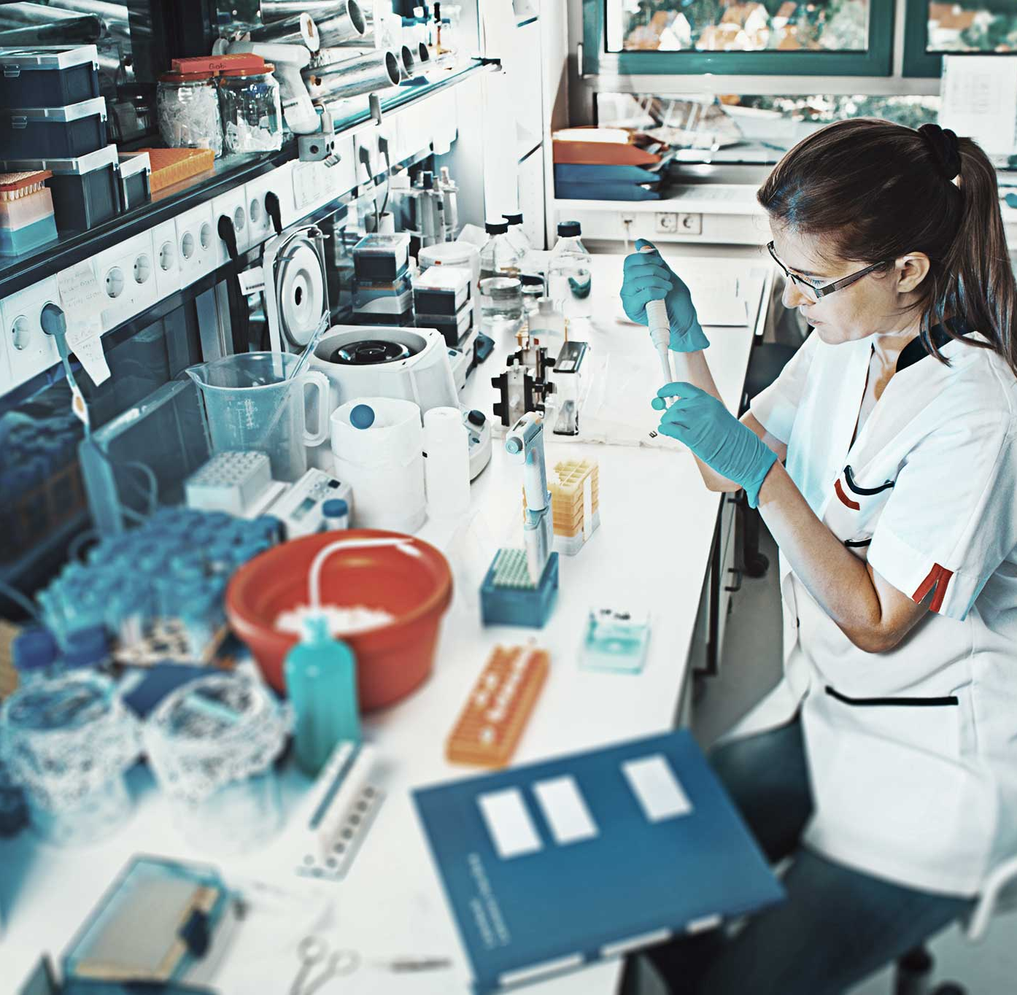
BII Labs
BII Labs
Currently 850 square meters of GMO 1 classified open special labs
  DNA/RNA lab
  Microscope lab
  Cell labs
  One lab is prepared for GMO 2
Will expand to >2,500 square meters of labs and >150 square meters of open workshops

Slide 7
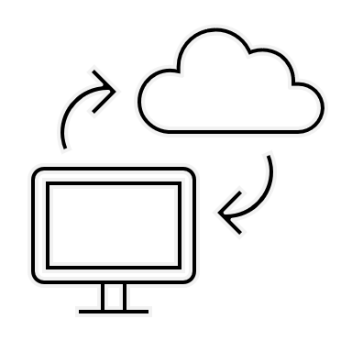





Modern Life Science research depends on a wide range of infrastructure
BII has established only basic infrastructure
Relies on collaboration with Danish universities on access to advanced infrastructure such as mass spectrometry, imaging, fermentation, cloud computing, high-throughput screening using robotics etc.
High performance computing
Chemistry & molecular biology facilities
Analytics
Automation
Imaging

Slide 8

Total BII (excl.Faculty)
Granted funding by BII vs. granted external funding (accumulated)
Split between loans, grants and investments
50
Start-ups
from 2018-2022
Loans
Grants
Investments
Million EUR
46
Start-ups received external funding
3
Series A investments> 10M EUR
11
Seed investments
> 1M EUR
92%
of portfolio have raised external funding since 2018
158M
EUR raised in external funding by our portfolio
18
Other investments < 1M EUR
85
Additional grants
3.5x
external funding leverage in average across portfolio
5
companies transitioned from VL to CH
2018
2019
2020
2021
2022
BII funding
Total external funding
Updated: 01.03.2022
Notes:
21%. Dobbeltcheck. 5 companies from VL to CH: CircleBioMedical, Inprother, Lephora, TwelveBio, Bainan
2021 numbers have not been quality checked.
* redrawn loans are subtracted
* 3x leverage includes external but no internal funding data from 2021.
A start-up can only be represented in one program. Therefore two more start-ups (Twelve Bio and Lophora), receiving grants from Venture Lab have also received additional funding, but since they also have received a grant from Creation House, the start-up and additional funding is counted there.
+ 6 Mil EUR I privat investering

Slide 9
BII is growing
We project to be 411 people by 2025 reaching the capacity of the current premises at COBIS.
We need facilities that both cover our long- term projected needs and support the fulfillment of the vision to develop BII into a world-leading innovation center for life science.
The scale-up of BII is currently being negotiated with COBIS and Pension Danmark.
*Includes start-ups, corporate partners, advisors and staff

Slide 10
BII Domicile

Slide 11


Questions?
Apply on our webpage
and stay in touch
Webpage: BII.dk
E-mail: info@bii.dk

