Slide 1
Vejen fra Silicon Valley til Forretningsstrategi
ATV Tech Talk 8th June, 2020

Slide 2
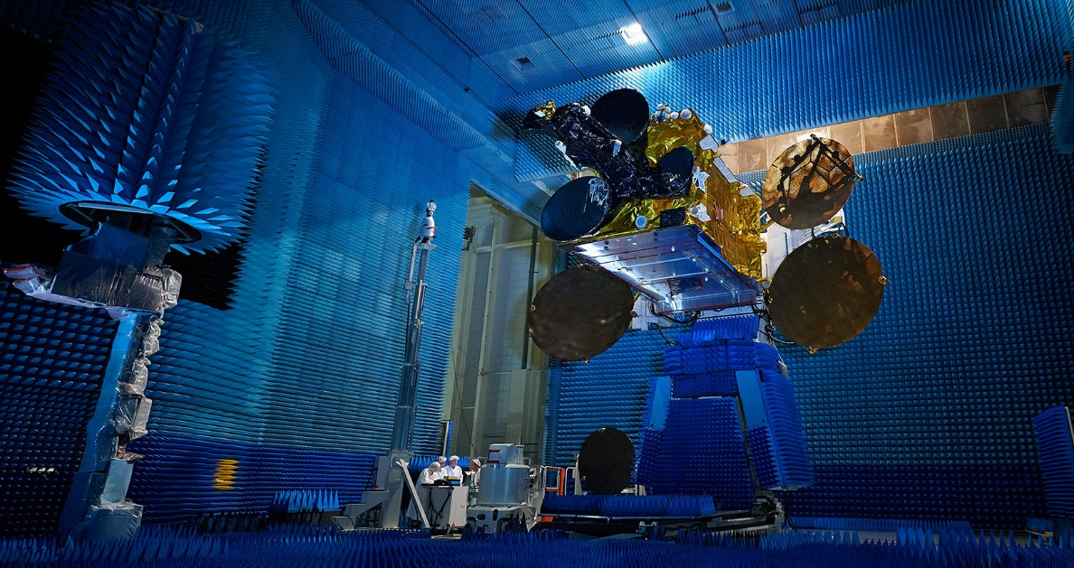
The majority of the world’s large satellites have
antennas designed using TICRA’s software solutions

Slide 3
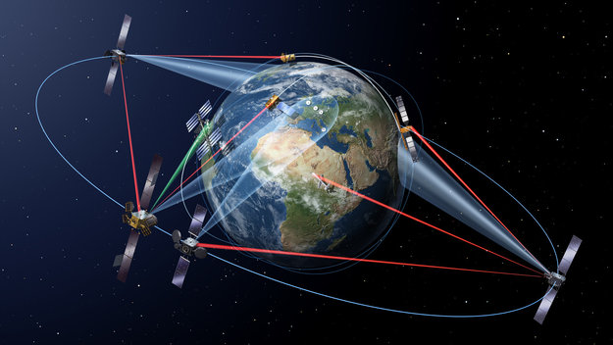


Connecting the world
Observing our globe

Slide 4
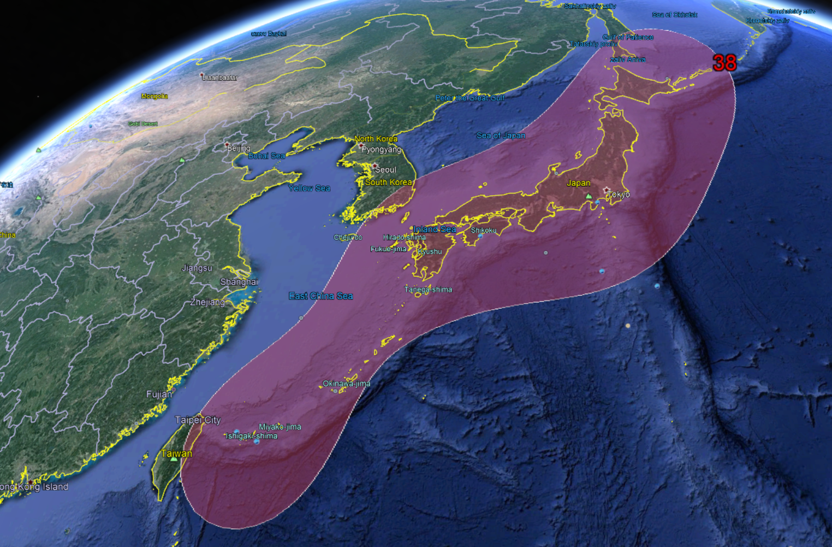
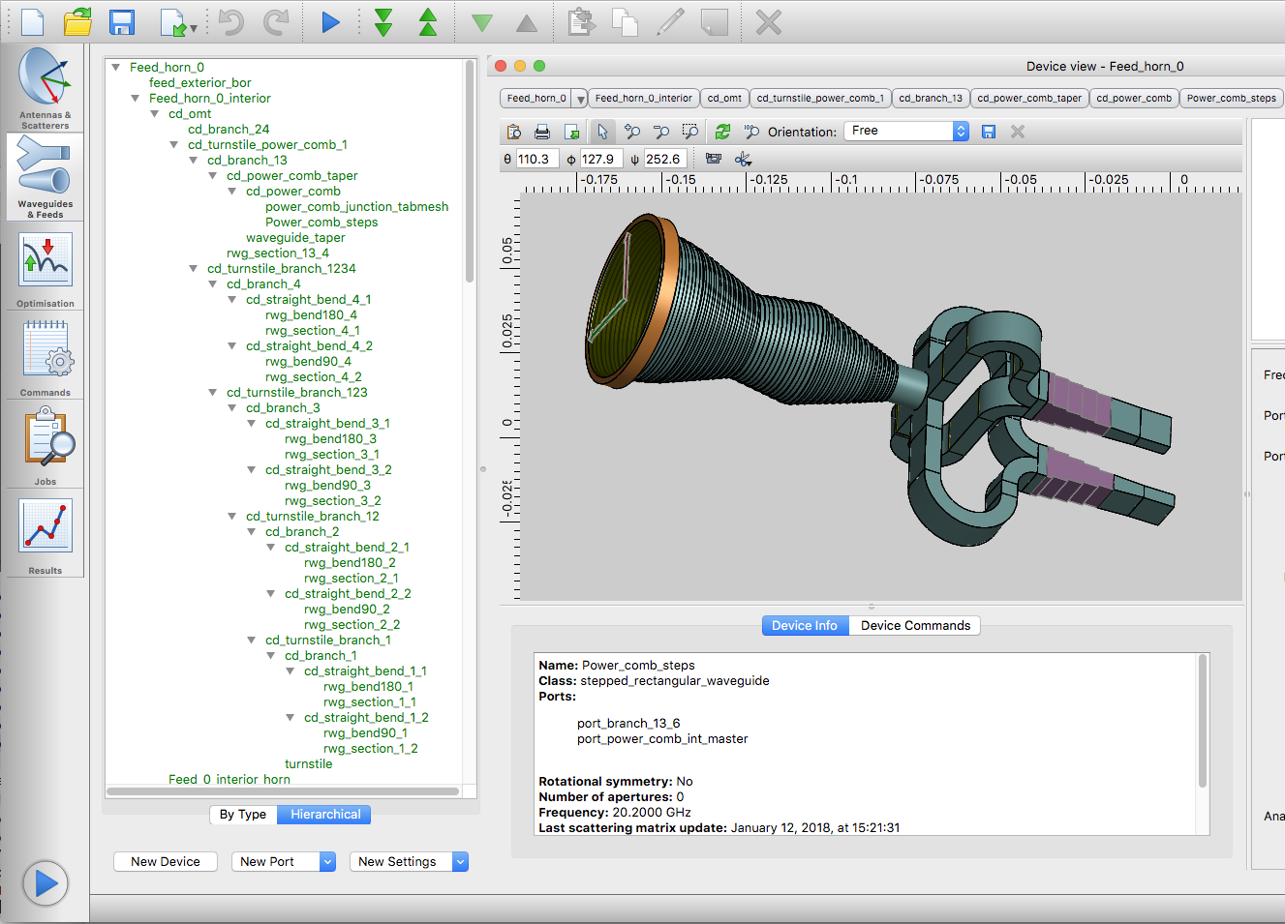
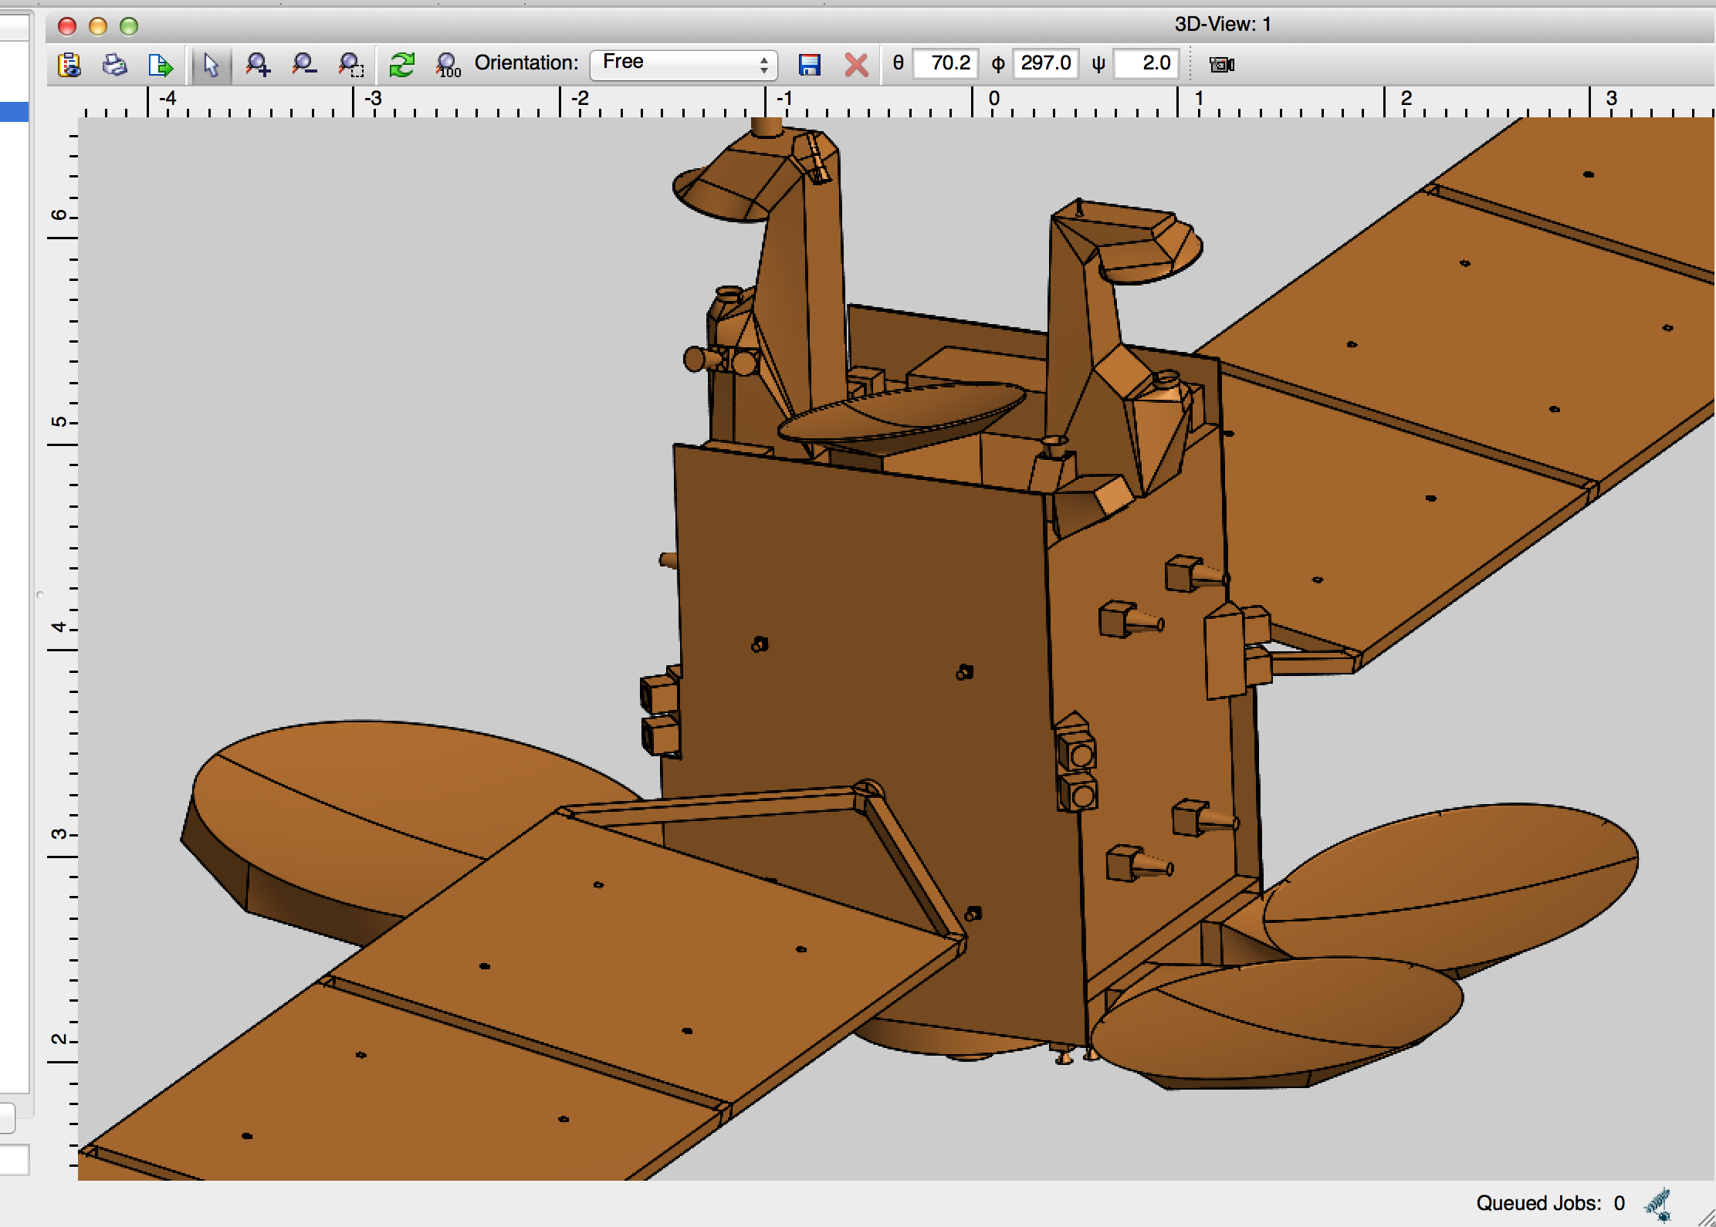
Digital Satellite Antenna Models

Slide 5
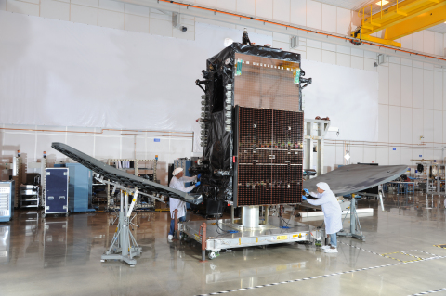
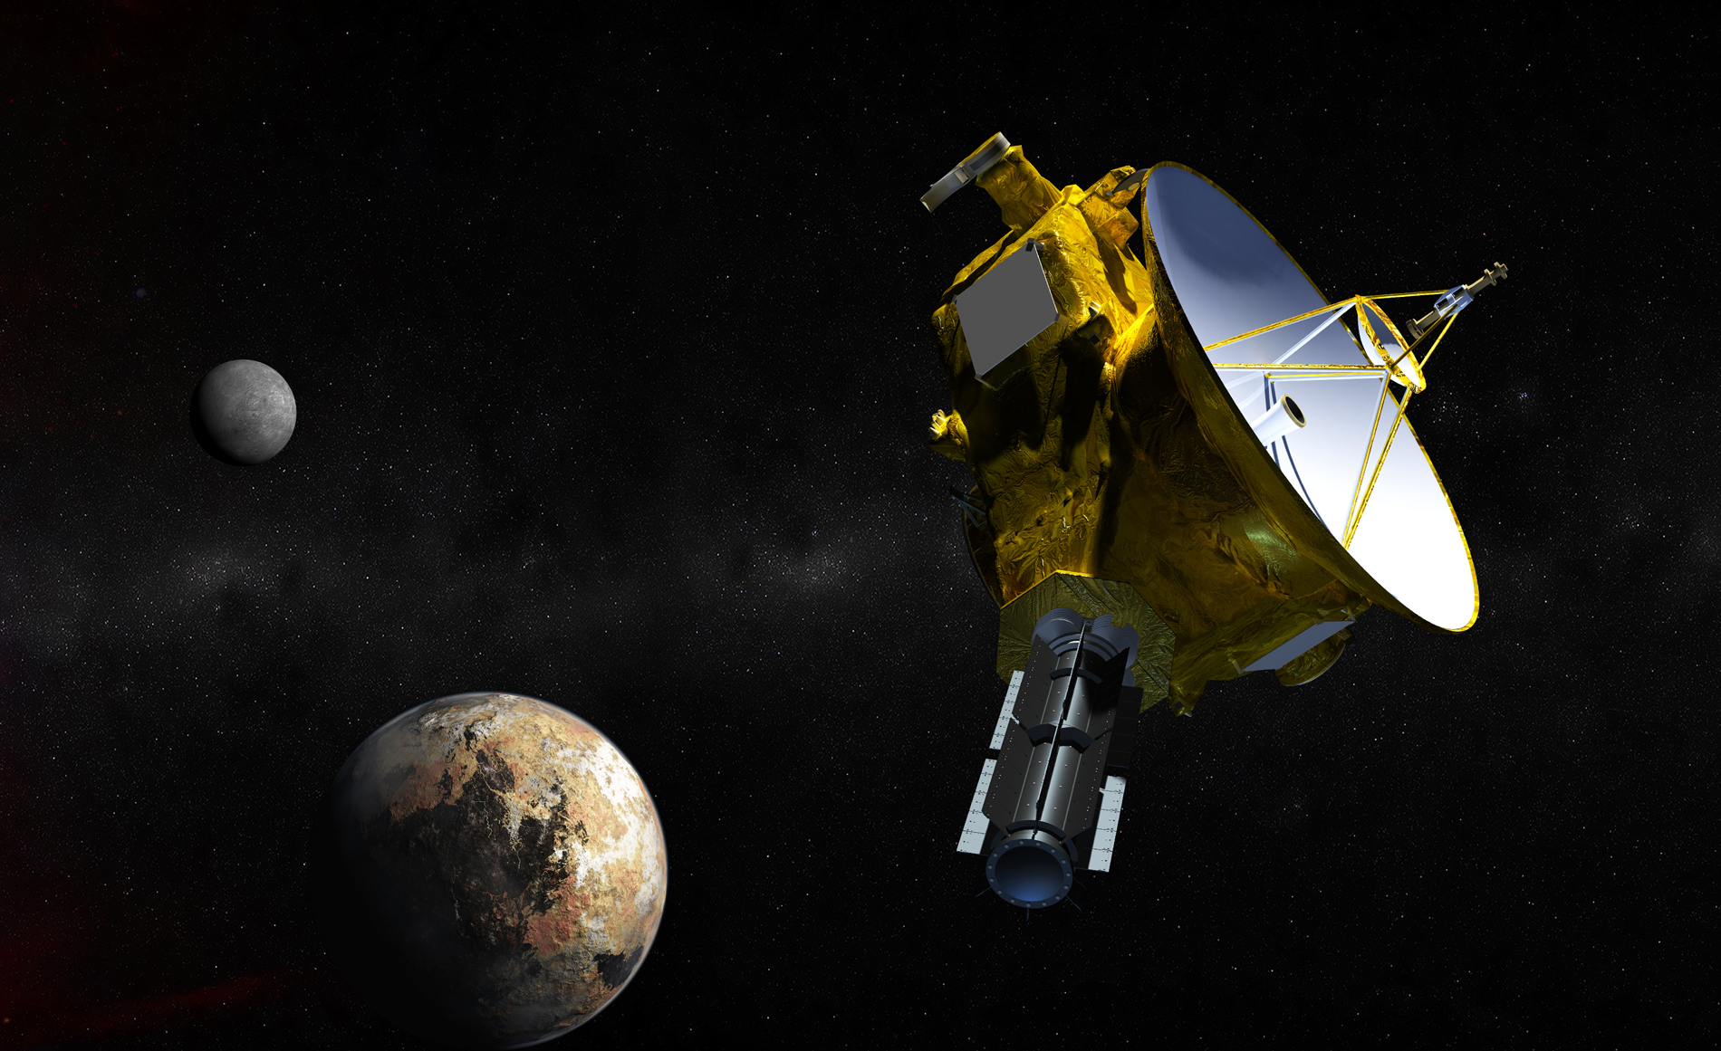









Key Customers
Satellite Manufacturers
Satellite Operators
Space Agencies

Slide 6

Applied AI Academy, 18-22 Nov. 2019
Høre om det nyeste inden for AI og blive klædt på til at adskille hype fra realiteter
Møde store og små virksomheder, danske og USA-baserede, som arbejder med kunstig intelligens
Lære at identificere, konkretisere og designe AI-baserede løsninger
Få indsigt i forretningsmæssige innovationsmodeller og ”innovation management”
Navigere imellem disruptive trends og emerging teknologier
Blive en del af et vidensbaseret AI-netværk i Danmark og Silicon Valley
Mulighed for at engagere sig i de mest lovende danske AI-baserede start-ups
Opbygge og udbygge netværk i Silicon Valley
Give luft under vingerne til jeres innovationsprojekter

Slide 7
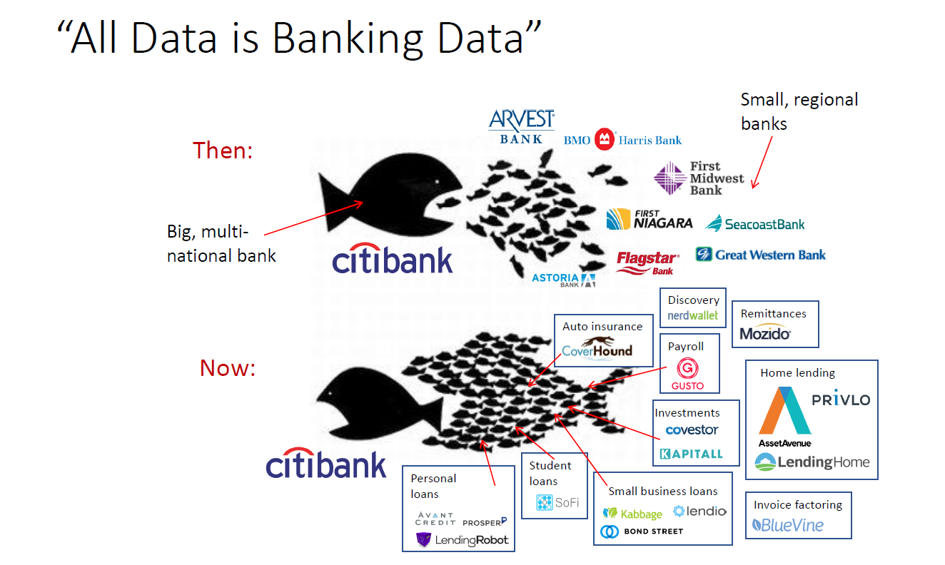
Key Take-Away #1: Where are you in the fish pond?
From the presentation “Terminator vs. Iron Man” by Shomit Ghose, GP, ONSET Ventures. Used with permission.

Slide 8
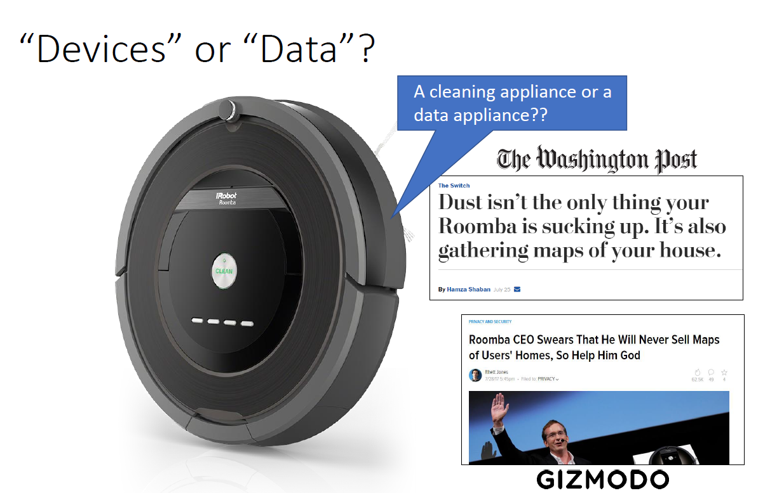
Key Take-Away #2: A data-centric vision of the future
Think of your assets:
Don’t give data away!
Say to your customer:
“You may own the data, but we want the right to also correlate it!”
From the presentation “Terminator vs. Iron Man” by Shomit Ghose, GP, ONSET Ventures. Used with permission.

Slide 9
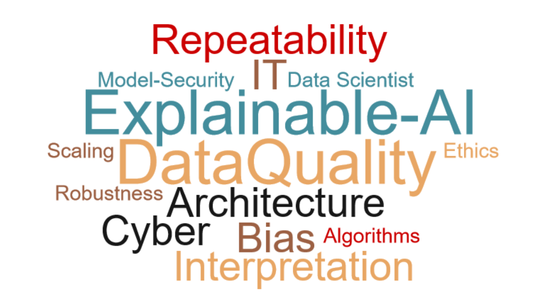
Key Take-Away #3: Operational AI may seem like a big obstacle

Slide 10
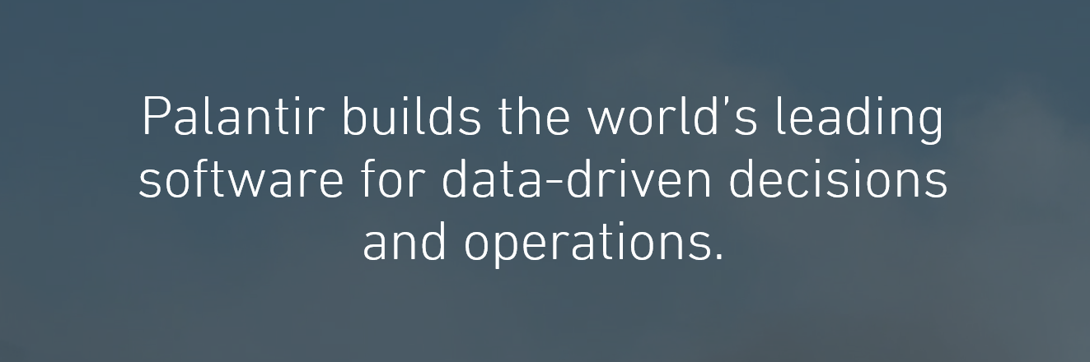
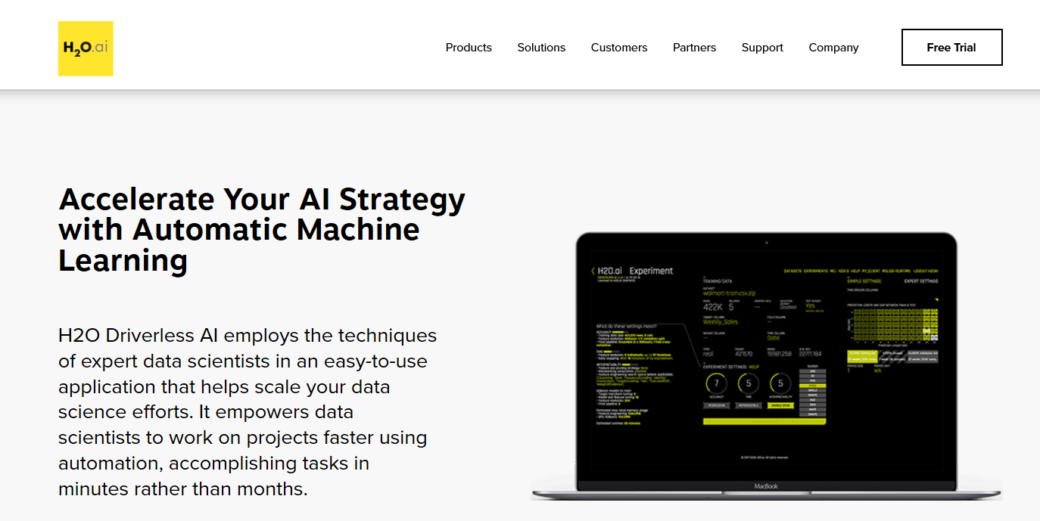
Key Take-Away #3: Operational AI may seem like a big obstacle
….. but there is help to get flying.

Slide 11

WHY
HOW
Explore Opportunities
Offer the customer to do it better
Meet Expectations
Offer the customer to do more
Mitigate Risks
Offer to do it for the customer
Products (no data)
Alone
Service (correlate data)
With new players
Platform (own data)
With competitor
WHAT
WHO

Slide 12
From Strategy to Action
New Team: “Math & AI”
Hiring new employees
Start cooperating with key knowledge institutions
Participation conferences,
AI Academy
Strategy Guiding Map
Pilot Projects

Slide 13
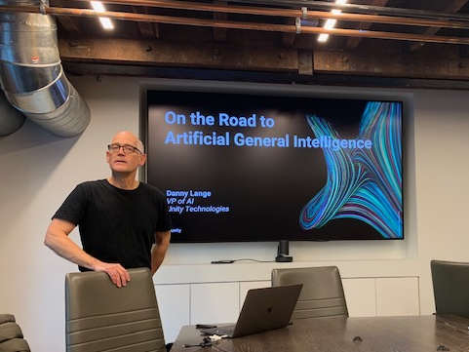
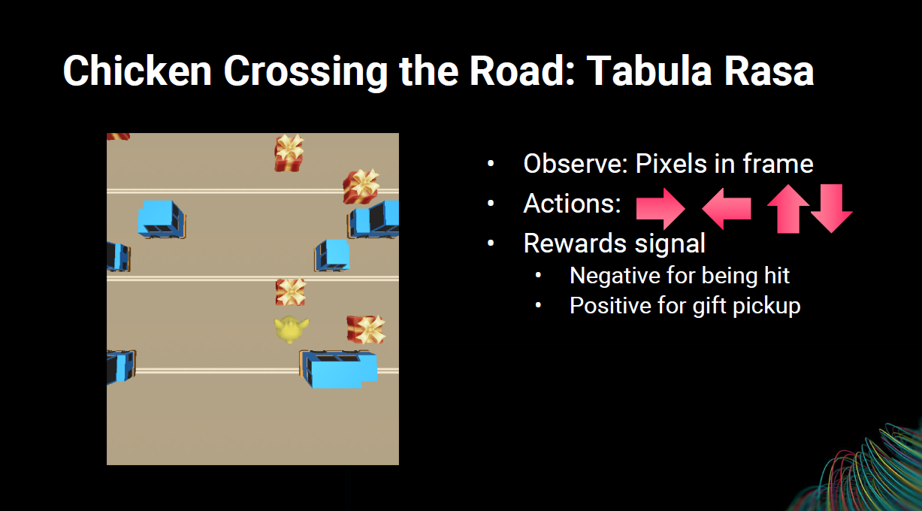
Reinforcement Learning

Slide 14
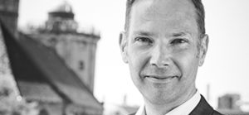
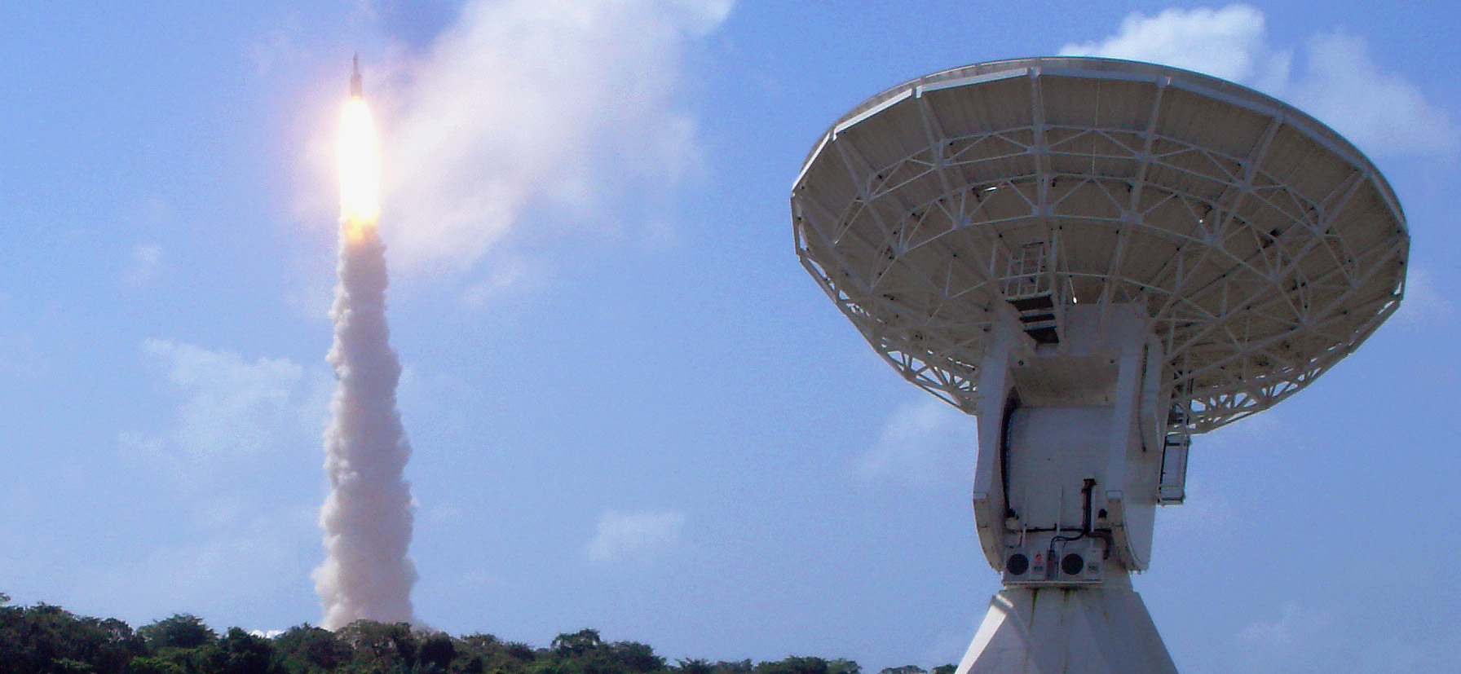
Further Info
Michael Lumholt
CEO
ml@ticra.com
Applied AI-Academy, Nov. 2019
Akademiet for de Tekniske Videnskaber (ATV)
jg@atv.dk; fk@atv.dk
Innovation Center Denmark Silicon Valley

