Slide 1
Test & demonstration in the Aquaporin Inside® pipeline
01 April 2022
CONFIDENTIAL

Slide 2
Aquaporin Inside® pipeline
~1 x cost
~5 x cost
~5 x cost
R&D
Proof of concept
Piloting
Production
Market Relation to UN SDGs
Drinking Water
Industrial Water
Food & Beverage
Medical Devices
Desalination

Slide 3
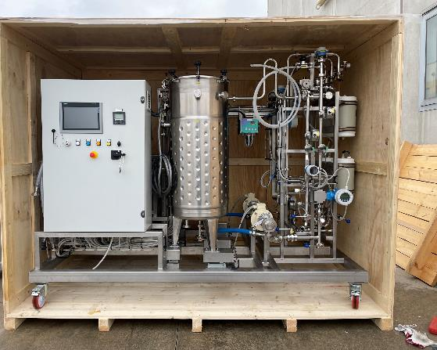
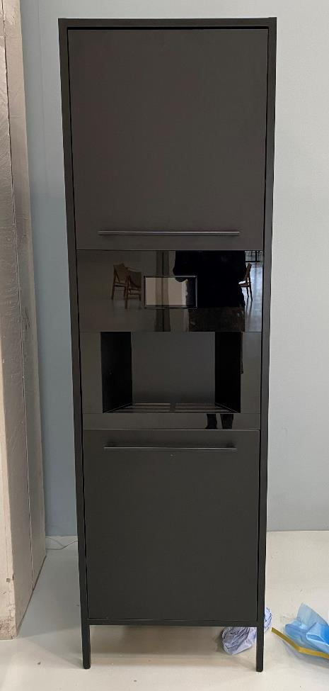
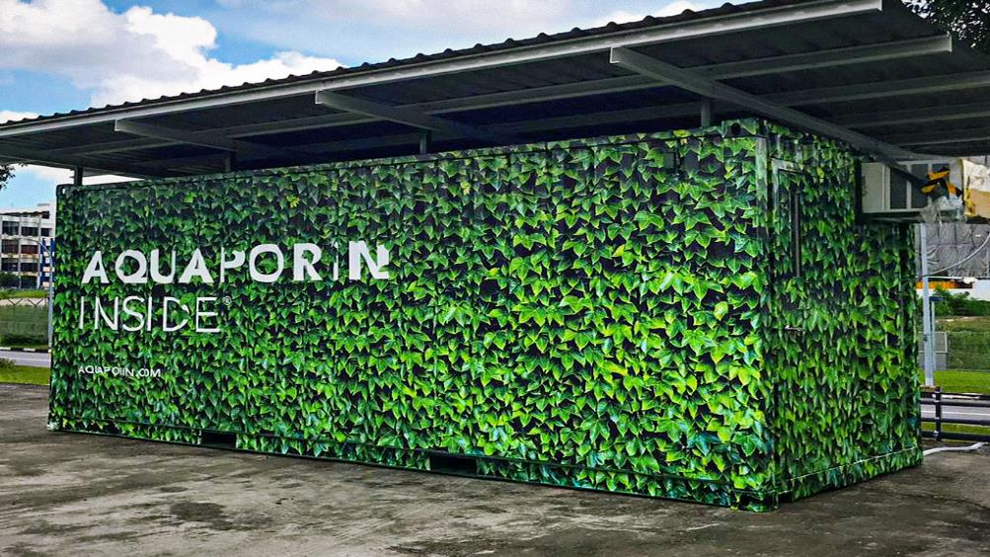
Piloting in 3 market segments
Test & demo in Drinking water in Asia & EU ~100%
Test & demo in F&B in Asia & EU ~100%
Test & demo in Industrial water in Asia & EU ~95%.
~5% in DK

Slide 4
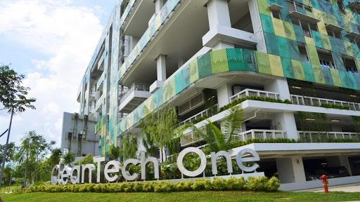
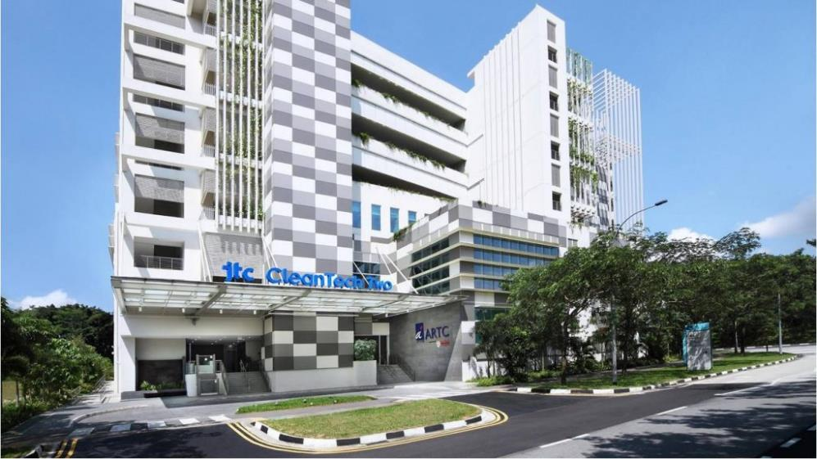
Target on 20-30% energy reduction in NEWater RO treatment process

Slide 5
At Aquaporin, we believe this is just the beginning.

